Slide 1
CHAPTER 2
Number Systems
Part 2

Slide 2
Objectives
After studying this chapter, the student should be able to:
Understand the concept of number systems.
Distinguish between non-positional and positional number systems.
Describe the decimal, binary, hexadecimal, and octal system.
Convert a number in binary, octal, or hexadecimal to a number in the decimal system.
Convert a number in the decimal system to a number in binary, octal, and hexadecimal.
Convert a number in binary to octal and vice versa.
Convert a number in binary to hexadecimal and vice versa.
Find the number of digits needed in each system to represent a particular value.

Slide 3
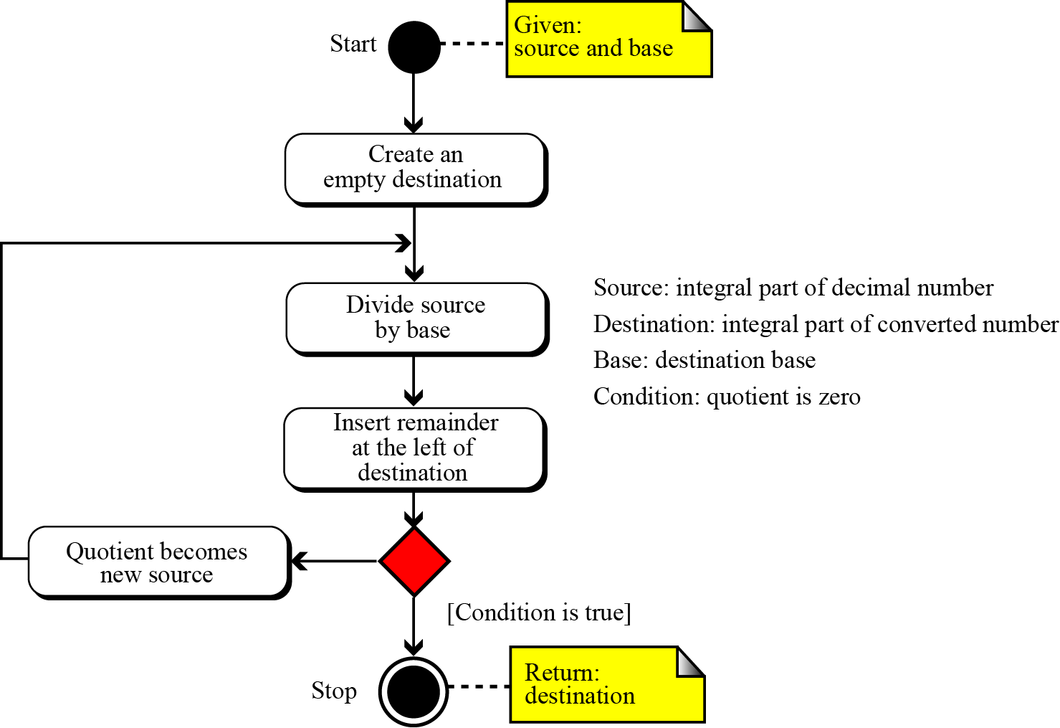
Decimal to any base
Figure 2.6 Converting other bases to decimal (integral part)

Slide 4
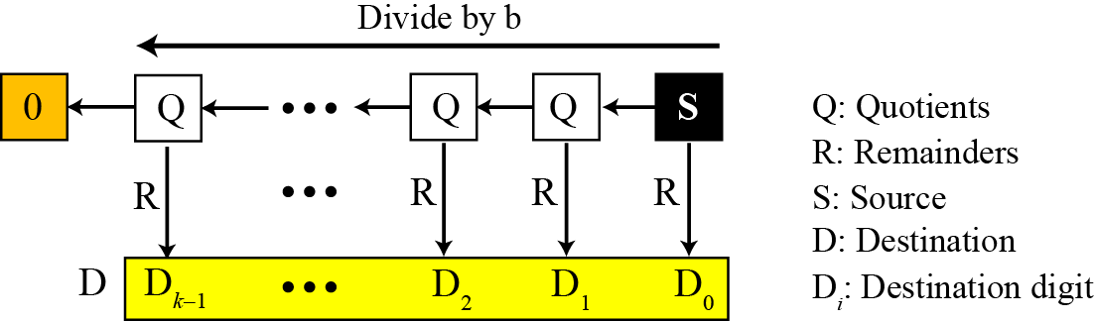
Figure 2.7 Converting the integral part in decimal to other bases

Slide 5
Example 2.11
The following shows how to convert 35 in decimal to binary. We start with the number in decimal, we move to the left while continuously finding the quotients and the remainder of division by 2. The result is 35 = (100011)₂.

Slide 6
Example 2.12
The following shows how to convert 126 in decimal to its equivalent in the octal system. We move to the right while continuously finding the quotients and the remainder of division by 8. The result is 126 = (176)₈.

Slide 7
Example 2.13
The following shows how we convert 126 in decimal to its equivalent in the hexadecimal system. We move to the right while continuously finding the quotients and the remainder of division by 16. The result is 126 = (7E)₁₆
A = 10, B = 11, C = 12, D = 13, E = 14, F=15
126/16 = 7 rem 14
7/16 = 0 rem 7

Slide 8
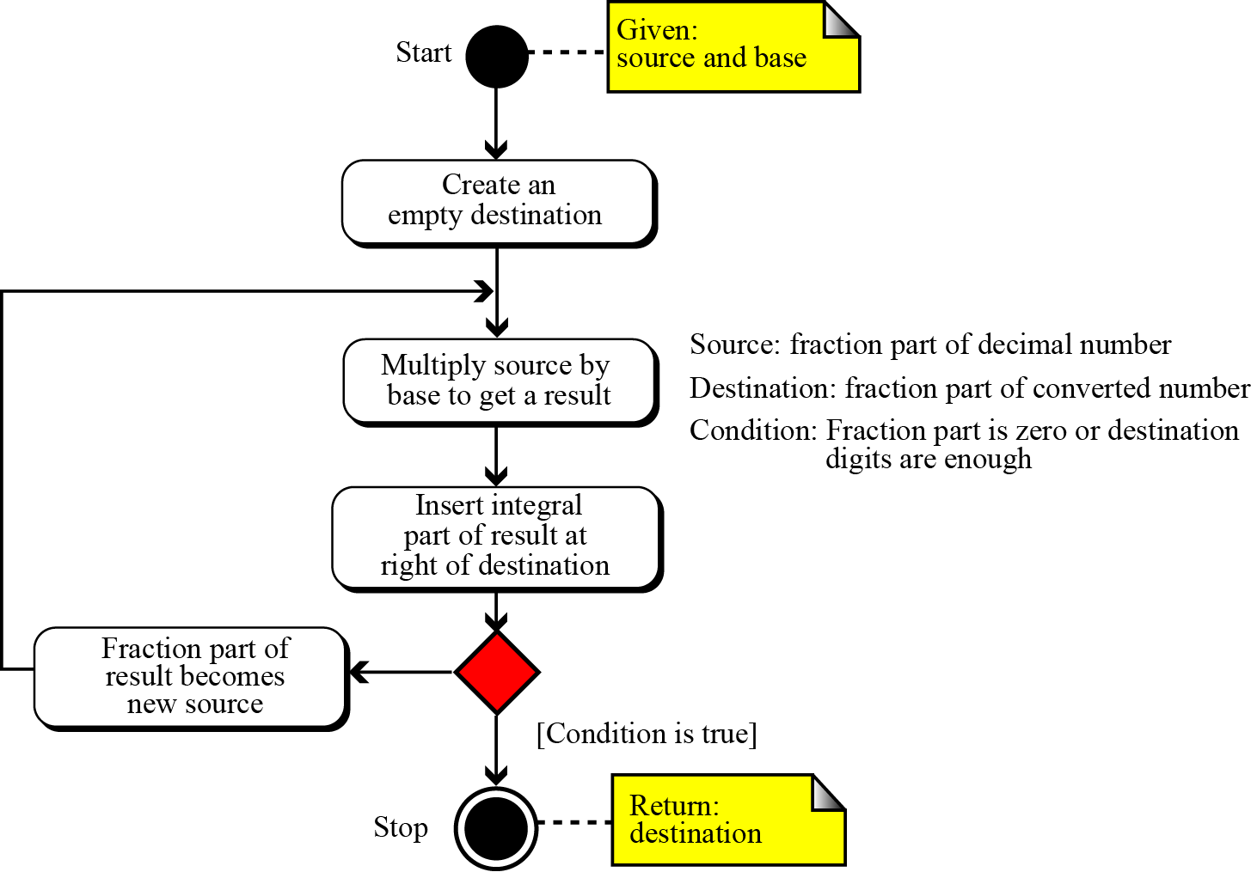
Figure 2.8 Converting fractional part in decimal to other bases

Slide 9
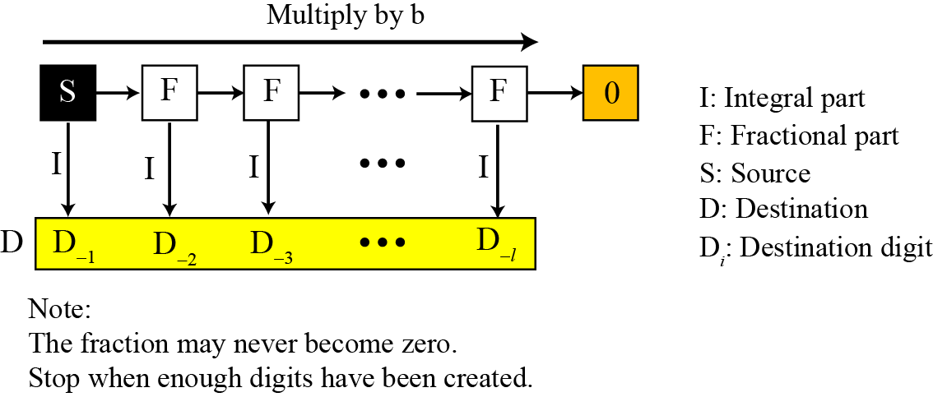
Figure 2.9 Converting fractional part

Slide 10
Example 2.14
Convert the decimal number 0.625 to binary.
0,625 X 2 = 1.25
0,25 X 2 = 0,5
0,5 X 2 = 1, 0
Since the number 0.625 = (0.101)₂ has no integral part, the example shows how the fractional part is calculated.

Slide 11
Example 2.15
The following shows how to convert 0.634 to octal using a maximum of four digits. The result is 0.634 = (0.5044)₈. Note that we multiple by 8 (base octal).
0,634 X 8 = 5,072
0,072 X 8 = 0,576
0,576 X 8 = 4,608
0,608 X 8 = 4,864

Slide 12
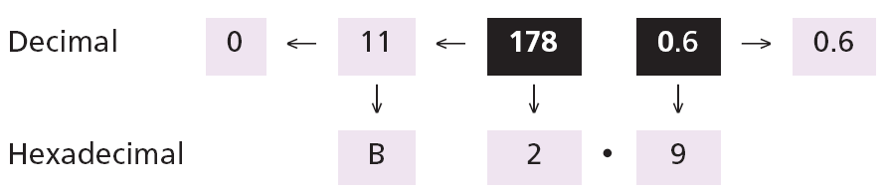
Example 2.16
The following shows how to convert 178.6 in decimal to hexadecimal using only one digit to the right of the decimal point. The result is 178.6 = (B2.9)₁₆ Note that we divide or multiple by 16 (base hexadecimal).
Repetitive Division
178/16 = 11 rem 2
11/16 = 0 rem 11
Repetitive multiplication
0,6 X 16 = 9,6

Slide 13
Example 2.17
An alternative method for converting a small decimal integer (usually less than 256) to binary is to break the number as the sum of numbers that are equivalent to the binary place values shows:

Slide 14
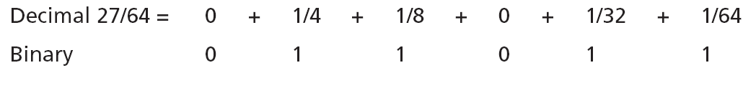
Example 2.18
A similar method can be used to convert a decimal fraction to binary when the denominator is a power of two:
The answer is then (0.011011)₂

Slide 15
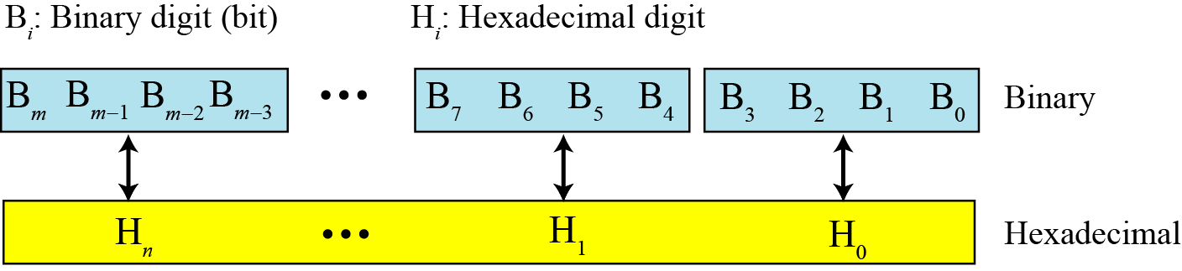
Binary-hexadecimal conversion
Figure 2.10 Binary to hexadecimal and hexadecimal to binary conversion

Slide 16
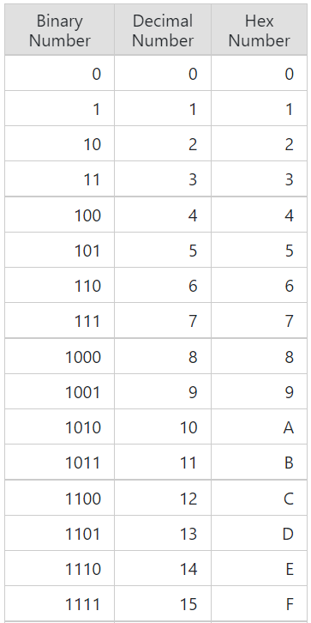
Example 2.19
Show the hexadecimal equivalent of the binary number (10011100010)₂.
Solution
We first arrange the binary number in 4-bit patterns:
100 1110 0010
Note that the leftmost pattern can have one to four bits. We then use the equivalent of each pattern shown in Table 2.2 on page 25 to change the number to hexadecimal: (4E2)₁₆.

Slide 17
Example 2.20
What is the binary equivalent of (24C)₁₆?
Solution
Each hexadecimal digit is converted to 4-bit patterns:
2 → 0010, 4 → 0100, and C → 1100
The result is (001001001100)₂.

Slide 18
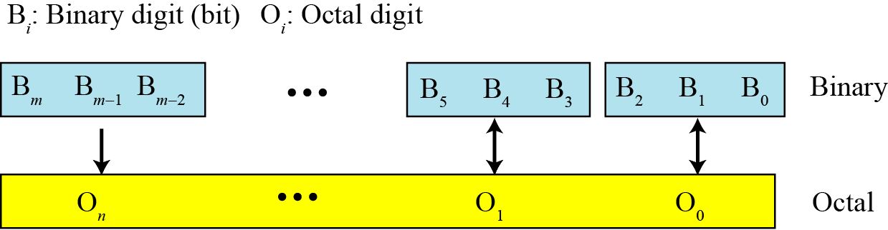
Binary-octal conversion
Figure 2.10 Binary to octal and octal to binary conversion

Slide 19
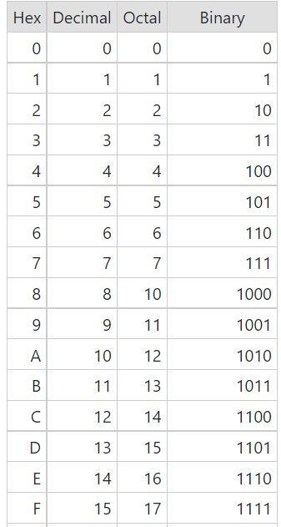
Example 2.21
Show the octal equivalent of the binary number (101110010)₂.
Solution
Each group of three bits is translated into one octal digit. The equivalent of each 3-bit group is shown in Table 2.2 on page 25.
101 110 010
The result is (562)₈.

Slide 20
Example 2.22
What is the binary equivalent of for (24)₈?
Solution
Write each octal digit as its equivalent
bit pattern to get
2 → 010 and 4 → 100
The result is (010100)₂.

Slide 21
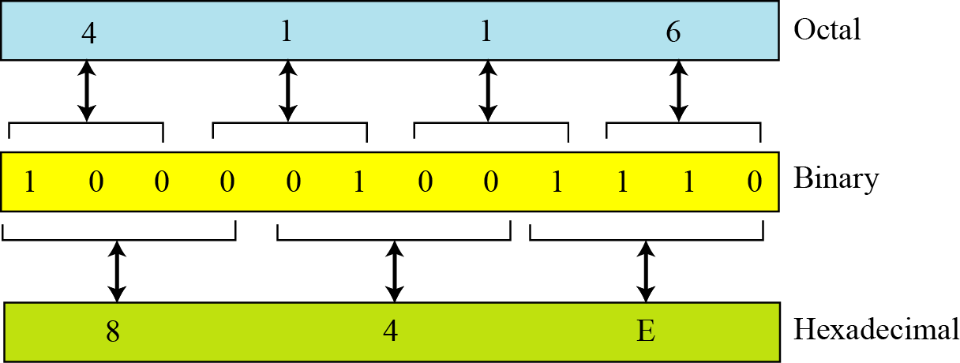
Octal-hexadecimal conversion
Figure 2.12 Octal to hexadecimal and hexadecimal to octal conversion

Slide 22
Example 2.23
Find the minimum number of binary digits required to store decimal integers with a maximum of six digits.
Solution
k = 6, b₁ = 10, and b₂ = 2. Then
x = ⎡k × (logb₁ / logb₂)⎤ = ⎡6 × (1 / 0.30103)⎤ = 20.
The largest six-digit decimal number is 999,999 and the largest 20-bit binary number is 1,048,575. Note that the largest number that can be represented by a 19-bit number is 524287, which is smaller than 999,999. We definitely need twenty bits.

Slide 23
2-3 NONPOSITIONAL NUMBER SYSTEMS
Although non-positional number systems are not used in computers, we give a short review here for comparison with positional number systems. A non-positional number system still uses a limited number of symbols in which each symbol has a value. However, the position a symbol occupies in the number normally bears no relation to its value—the value of each symbol is fixed. To find the value of a number, we add the value of all symbols present in the representation.

Slide 24
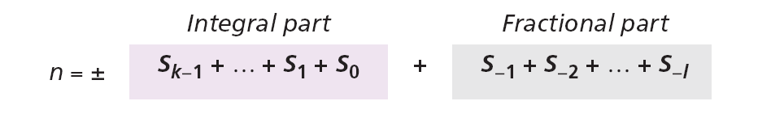
In this system, a number is represented as:
and has the value of:
There are some exception to the addition rule we just mentioned, as shown in Example 2.24.

Slide 25
Example 2.24
Roman numerals are a good example of a non-positional number system. This number system has a set of symbols S = {I, V, X, L, C, D, M}. The values of each symbol is shown in Table 2.3
To find the value of a number, we need to add the value of symbols subject to specific rules (See the textbook).

Slide 26
Example 2.24
(Continued)
The following shows some Roman numbers and their values.

Slide 27
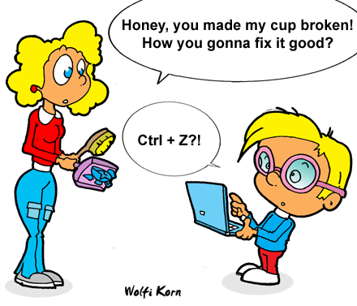
The End

